Slide 1
REMOTE MEDICAL ASSISTANCE SYSTEM
PRESENTED BY:
TM ABDUL KHADER
SIVAKUMAR S
KIRAN J CHEMMANATTE

Slide 2
Index…
Motivation behind project
How is the project helpful
Working details
Technical details
Current status
Future prospective

Slide 3
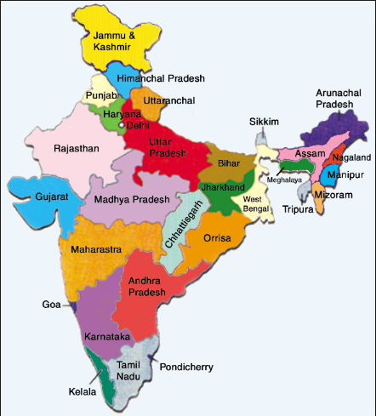

Motivation Behind Project..
Inadequacy of doctors in India
Pop of India Pop of doctors
1.33bn 1.03million

Slide 4
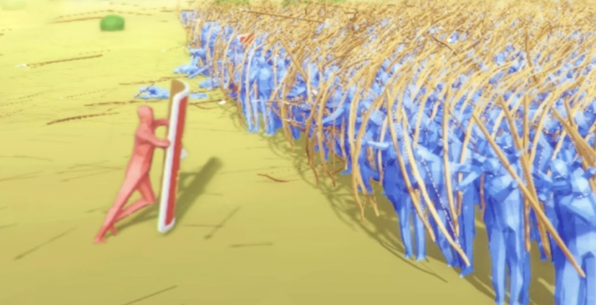
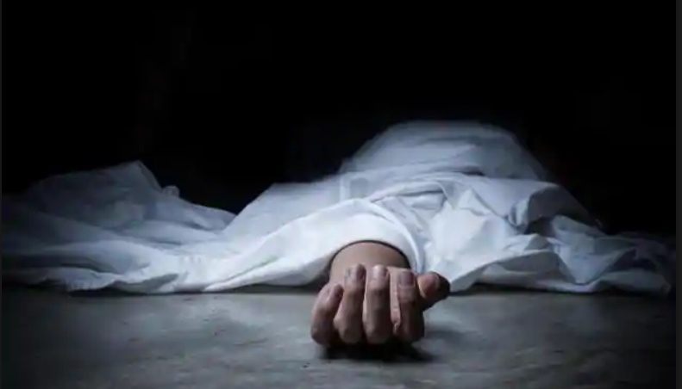
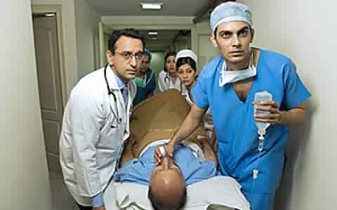
This results in a doctor to patient
ratio of 1:1000.
The consequences:
The consequences: deaths due to medical negligence
Our mission:
To automate the system and provide le alerts.

Slide 5
How is the project helpful??.....
Can be used in clinics, hospital rooms for taking medical readings without external assistance
Doctors can take medical readings of patient any time from anywhere in the World!!!
Could be used for domestic medical Assistance- Doctor can monitor patient while he/she is at home.
RF controlled Portable device is used to alert Nurses about the bed and type of emergency in an emergency situation

Slide 6
Working Details….

Slide 7
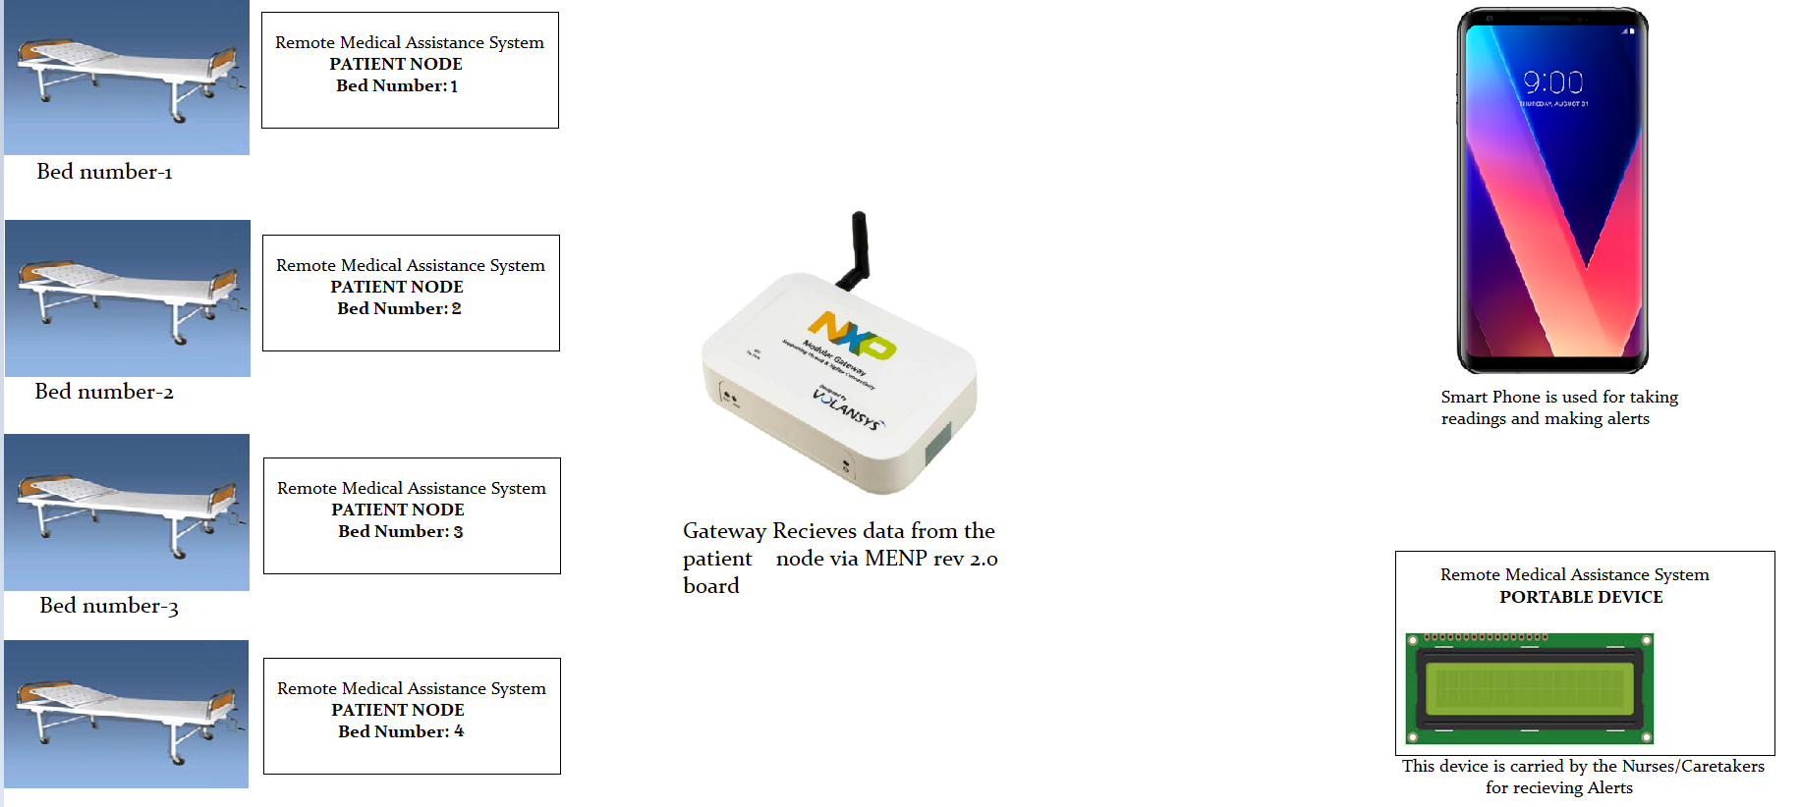
Project Architecture…..

Slide 8
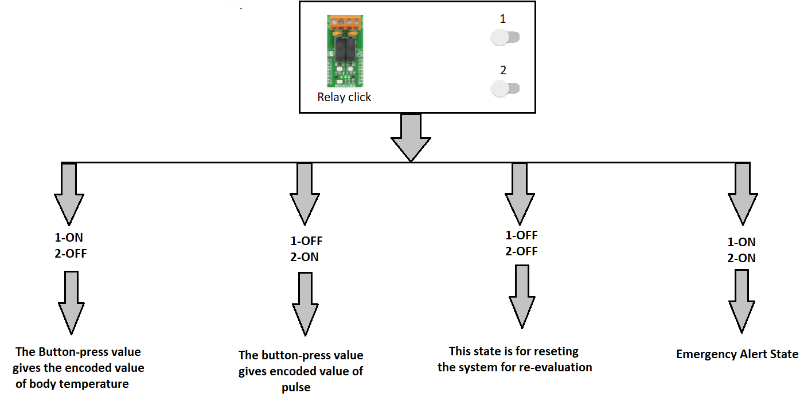
DESIGN FLOW-CHART – Mobile App

Slide 9
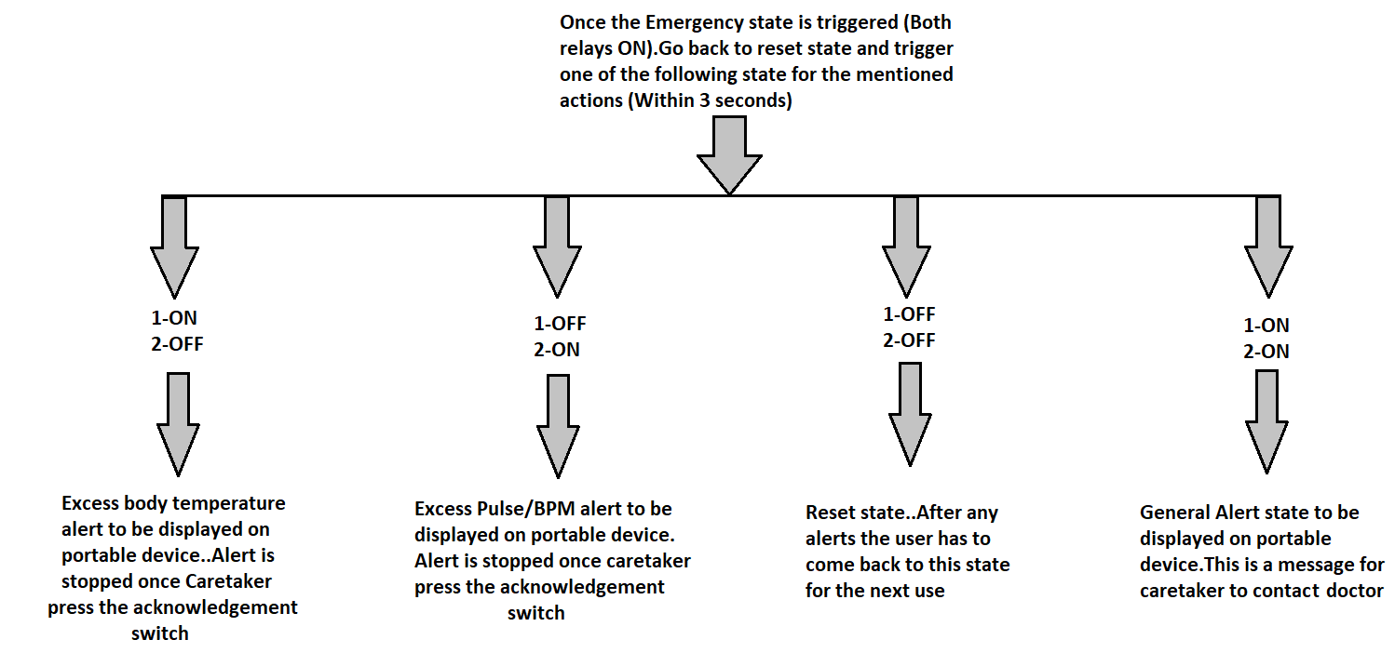
CONTINUATION

Slide 10
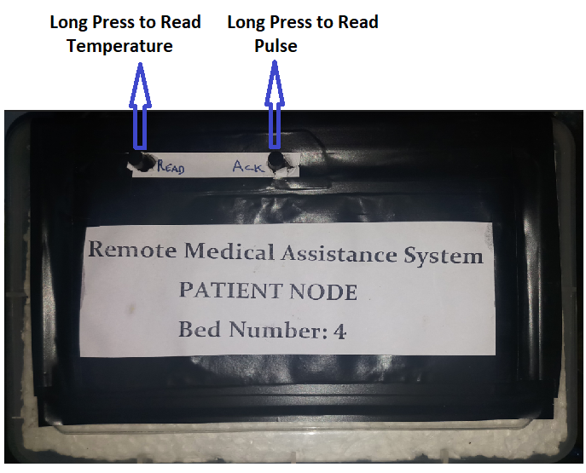
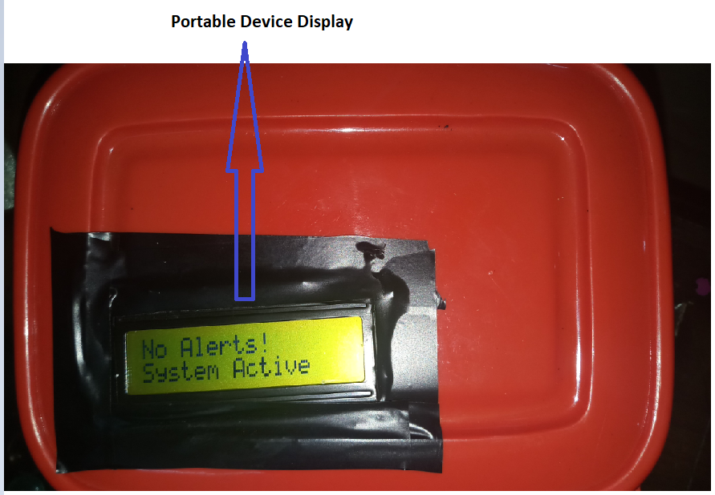


Working with the portable device…

Slide 11
Technical Details….

Slide 12
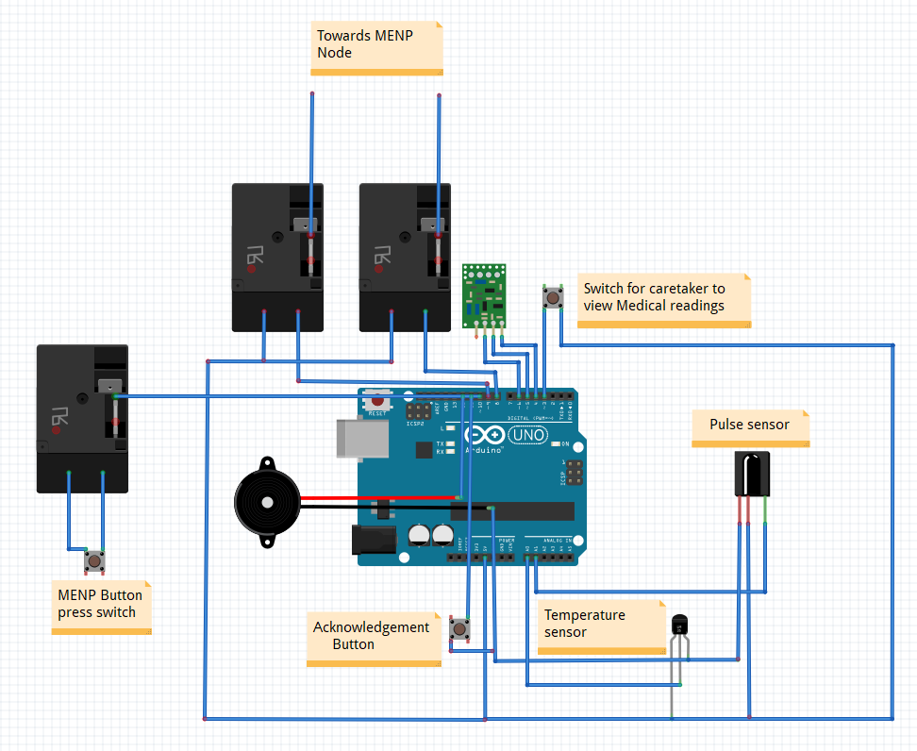
MENP Node to Sensor Interface Schematic

Slide 13
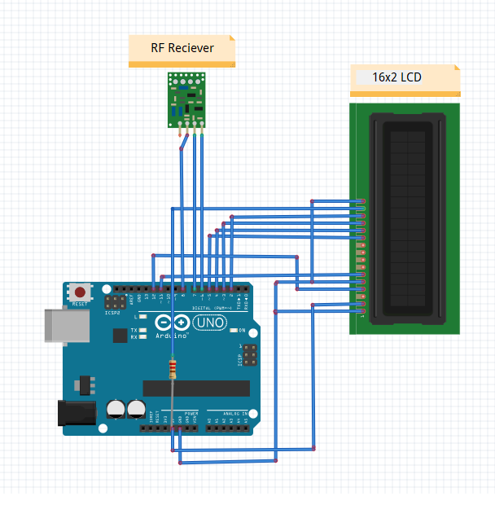
Wearable Device Schematic

Slide 14
Current Status…
Real time Temperature readings could be taken remotely via LM35 sensor and pre-fed pulse readings could also be taken.
Caretaker could alerted in case the doctor feels there is a case of emergency by pressing a switch.
Specific alerts like High temperature alert or abnormal pulse alert could be given
If the temperature goes beyond 100 degree Fahrenheit an automatic alert will be produced
Care-taker is issued with a personal portable device with a 16 x 2 display for getting alerts regarding a specific patient and for viewing medical readings
Database is created each time the doctor views the medical readings

Slide 15
Real time pulse reading couldn’t be taken (Elimination of noise from Infrared detector using ATMEGA 328p is time consuming).
Though Medical readings could be taken remotely it couldn’t be automated using pre-set timings ie.. the doctor or his assistant has to take the reading whenever required.
Imaging Unit couldn’t be placed.

Slide 16
Difficulties faced…
Lack of Proper Knowledge about IoT Gateway Architecture and its programming.
Couldn’t transfer data from MENP to cloud except for a data from Pushbutton with existing source codes
Limitation of time…

Slide 17
Future Prospective of the device….
If the process of taking medical readings is completely automated based on timings set, Doctor can just view the medical database whenever required…This can save a lot of time
More number of sensors could be interfaced…..
A collection of medical database from several patients in area could be kept to understand the medical trend in a place
The portable device for the caretaker could be made into a small Smart Medical Watch.
The patient Node could be integrated into a smaller system for improving the portability.

